Slide 1
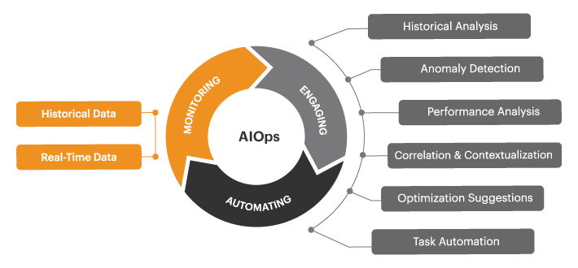
AIOps360 – Intelligent Support Command Center

Slide 2
Hackathon Team
Siddartha Jain
Pradyut Parida
Manish Chatla
Subhransu Mohapatra

Slide 3
Problem Statement
Develop a Gen-AI enabled Integrated Platform Environment with the following capabilities
Provided agentic capabilities for incident resolution
AI chatbot to contextually chat with GPT backend on the incident/issue support team personal working on.
Contextual recommendations with telemetry ,related incidents etc should provide proactive recommendation engine mapping to telemetry
Ability to leverage enterprise information for troubleshooting
Context based data extraction: Extract field like connectivity information, upstream and downstream dependency on simple query for the CI in question

Slide 4
Current Gaps in Incident Management
Fragmented alerting and monitoring systems.
Manual correlation of related incidents.
Lack of proactive and intelligent remediation.
Lack of automated determination of business impact based on contextual data
Lack of recommendation mechanism based on telemetry related to telemetry like error threshold, SLI etc.
Virtual assistant which can scan through multiple KBs, SOPs to help the support personal in measuring and resolving the issue at hand.

Slide 5
Our Solution: AIOps360
An integrated platform for real-time incident correlation and resolution.
AI-powered chatbot interface for support engineers.
Agentic automation to run remediation with minimal intervention.
Telemetry-based insights and recommendations.
Identifies true business impact based on Contextual data
Provides automated RCA and historical corelated incidents for better understanding if the issue at hand.

Slide 6
Architecture Overview
RAG
LLM
Correlation Engine
(ML/Rules)
Agentic AI
Telemetry Sources
Ingestion Layer
Support Dashboard
SOPS/KB
Impact Prediction Model
AI Chatbot
Line Graph

Slide 7
Core Features
Incident Correlation Engine
AI Chatbot for Historical Insights & SOPs
Agentic Automation Trigger System
Unified Dashboard for Support Engineers
Telemetry Pattern Analysis & Recommendations
Accurate Impact prediction based on upstream & downstream flow

Slide 8
Chatbot & Automation Capabilities
Natural language interface for incident queries.
Trigger diagnostic or remediation workflows.
Retrieve related SOPs and historical incident details.
Auto-suggest actions based on telemetry patterns.

Slide 9
Technology Stack
Python
Gradio for UI
OpenAI chatgpt model for LLM and embeddings
Langchain for Agentic-AI

Slide 10
Q&A?

